Slide 1
Blacktown Chinese Christian Church
Welcome to Our English Service 20.04.2025
English Service 9:45 – 11:00 am
Worship Songs: Passage: Speaker: Topic: Response Song: Announcements and Closing Prayer Benediction
This I Believe 1Corinthians 15:1-11 Xavier Lakshmanan Christ's Resurrection: An Iconic Reminder TBA

Slide 2
BCCC english service

Slide 3

Please keep all phones on silent

Slide 4
This I Believe
CCLI Licence No: 42

Slide 5
Verse 1
Our Father everlasting
The all-creating One
God Almighty

Slide 6
Verse 1
Through your Holy Spirit
Conceiving Christ the Son
Jesus our Saviour

Slide 7
Chorus
I believe in God our Father
I believe in Christ the Son
I believe in the Holy Spirit
Our God is three in One

Slide 8
Chorus
I believe in the resurrection
That we will rise again
For I believe in the Name of Jesus

Slide 9
Verse 2
Our Judge and our Defender
Suffered and crucified
Forgiveness is in You

Slide 10
Verse 2
Descended into darkness
You rose in glorious light
Forever seated high

Slide 11
Chorus
I believe in God our Father
I believe in Christ the Son
I believe in the Holy Spirit
Our God is three in One

Slide 12
Chorus
I believe in the resurrection
That we will rise again
For I believe in the Name of Jesus

Slide 13
Bridge 1
I believe in You
I believe You rose again
I believe that Jesus Christ is Lord
(x2)

Slide 14
Chorus 2
I believe in life eternal
I believe in the virgin birth
I believe in the saints' communion
And in Your Holy Church

Slide 15
Chorus 2
I believe in the resurrection
When Jesus comes again
For I believe in the Name of Jesus

Slide 16
Chorus
I believe in God our Father
I believe in Christ the Son
I believe in the Holy Spirit
Our God is three in One

Slide 17
Chorus
I believe in the resurrection
That we will rise again
For I believe in the Name of Jesus

Slide 18
Tag
For I believe in the Name of Jesus
For I believe in the Name of Jesus

Slide 19
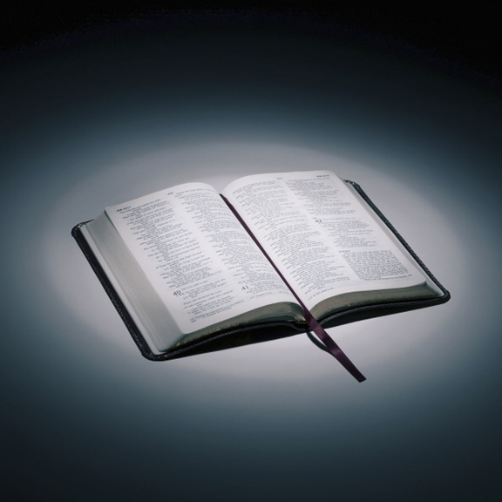
Bible reading

Slide 20
1Corinthians 15:1-11
Now, brothers and sisters, I want to remind you of the gospel I preached to you, which you received and on which you have taken your stand. ² By this gospel you are saved, if you hold firmly to the word I preached to you. Otherwise, you have believed in vain.

Slide 21
1Corinthians 15:1-11
³ For what I received I passed on to you as of first importance: that Christ died for our sins according to the Scriptures, ⁴ that he was buried, that he was raised on the third day according to the Scriptures,

Slide 22
1Corinthians 15:1-11
⁵ and that he appeared to Cephas, and then to the Twelve. ⁶ After that, he appeared to more than five hundred of the brothers and sisters at the same time, most of whom are still living, though some have fallen asleep.

Slide 23
1Corinthians 15:1-11
⁷ Then he appeared to James, then to all the apostles, ⁸ and last of all he appeared to me also, as to one abnormally born.

Slide 24
1Corinthians 15:1-11
⁹ For I am the least of the apostles and do not even deserve to be called an apostle, because I persecuted the church of God. ¹⁰ But by the grace of God I am what I am, and his grace to me was not without effect. No, I worked harder than all of them—yet not I, but the grace of God that was with me.

Slide 25
1Corinthians 15:1-11
¹¹ Whether, then, it is I or they, this is what we preach, and this is what you believed.

Slide 26
Announcements

Slide 27





Account name: Blacktown Chinese Christian Church
Account number: 4216 50263
Offering
BSB: 112 - 879
Please put in "offering" as the reference
The offering box is available at the back of the hall

Slide 28
Prayer points

Slide 29
Mingle time!

